Slide 1
Cardiovascular disease detection
Group 7: Wayne, Shao Chi,
Nicholas, Kern Yang

Slide 2
table of content
Introduction
Data preparation
01
02
Exploratory analysis and visualisation
Algorithmic optimisation
03
04

Slide 3
introduction
Problem Introduction, Statement and Objective

Slide 4
Problem Introduction
Cardiovascular diseases (CVD) is one of the leading causes of death globally according to WHO and MOH
At least three-quarters of the world's deaths from CVDs occur in low- and middle-income countries, and they often do not have the benefit of primary health care programmes for early detection and treatment of people with risk factors for CVDs.

Slide 5
Problem Statement
Cardiovascular diseases are prevalent, and early detection is crucial for effective treatment.

Slide 6
Problem Objective
Identify the most predictive variables for early detection and warning of cardiovascular diseases, and predict the chance of getting cardiovascular disease.
Binary Classification
Multi-variable Classification

Slide 7
Data Preparation
Dataset Clarity, Removing Outliers

Slide 8
Dataset
Clarity

Slide 9
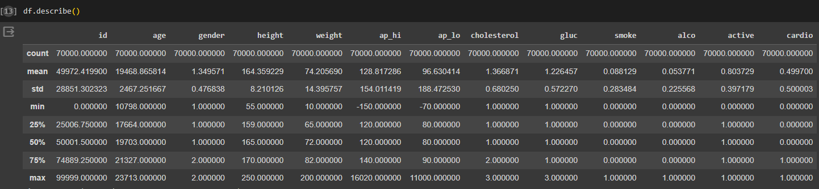
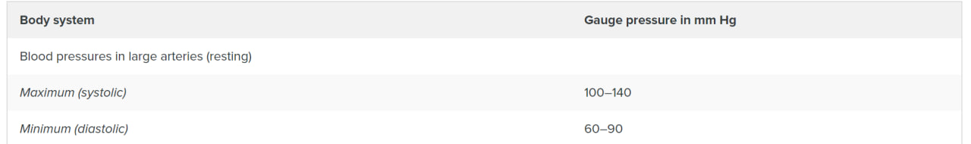
Using df.describe, we can clearly see that
Age is not displayed in years, but in days
Although Minimum Age = (10798/365) = 29 Years Old,
Minimum Height is 55cm, which is wrong
Minimum Weight is 10kg, which is wrong
For ap_hi and ap_lo,
A person's systolic blood pressure value should be within the range of 100-140
A person's diastolic blood pressure value should be within the range of 60-90

Slide 10
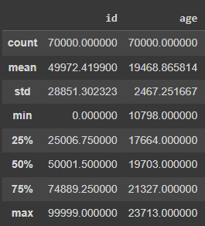
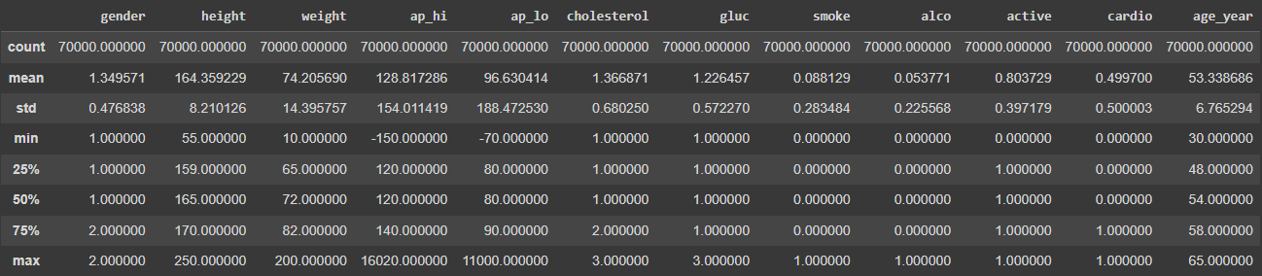
Creation of Age_Year Variable
Shows age in number of years, as opposed to the original age in the dataset, which showed age in number of days.
Removal of Age Variable
Misleading and unnecessary.

Slide 11
Determine Gender Variable
Gender given in dataset did NOT specify whether male / female is 1 / 2.
In order to determine gender, we take all data in Gender and find the Mean for Height and Weight for both Gender binary code.

Slide 12
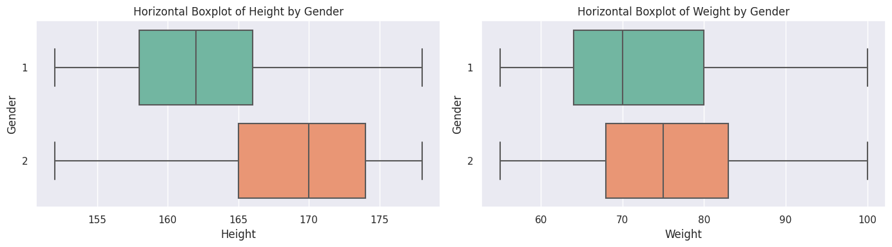
Mean of Height and Weight for Gender 1 and 2
Gender | Height | Weight
1 | 161.35 | 72.5
2 | 169.94 | 77.2
As Male are generally taller and heavier than Females, we can infer that 1 = Female and 2 = Male.

Slide 13
Removing Outliers and Anomalies

Slide 14
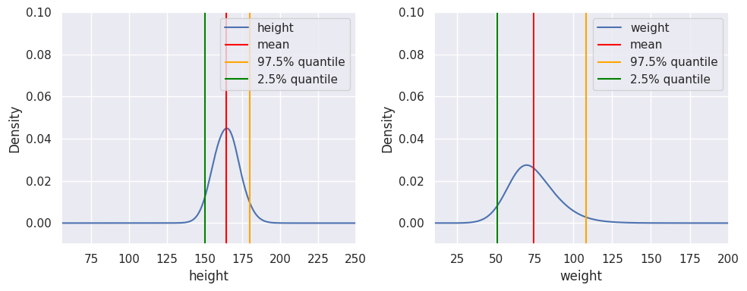
Removing Outliers [Height & Weight]
Using KDE Plot, we can find the values for the 2.5% and 97.5% quartile, and remove any anomaly and outliers outside of the 95% confidence.
 | Height (cm) | Weight (kg)
Min. | 150 | 52
Max. | 180 | 106

Slide 15
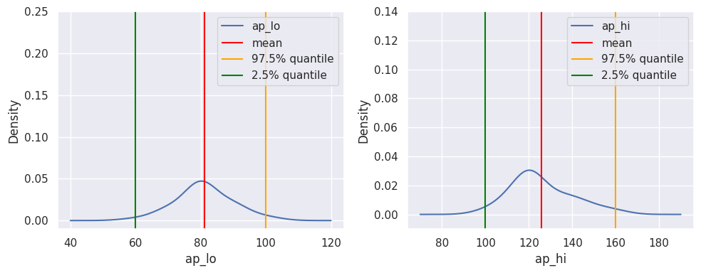
Removing Outliers [Ap_lo & AP_Hi]
Using KDE Plot, we can find the values for the 2.5% and 97.5% quartile, and remove any anomaly and outliers outside of the 95% confidence.
 | AP_Hi (Systolic) | AP_Lo (Diastolic)
Min. | 100 | 60
Max. | 163 | 100

Slide 16
Exploratory Analysis and Visualisation
Decision Tree, Confusion Matrix, Correlation Heatmap

Slide 17
Decision Tree
From the Decision Tree Model, we have found that the 5 most important variables with the lowest GINI for predicting Cardio is:
ap_hi
age_year
cholesterol
gluc
ap_lo

Slide 18
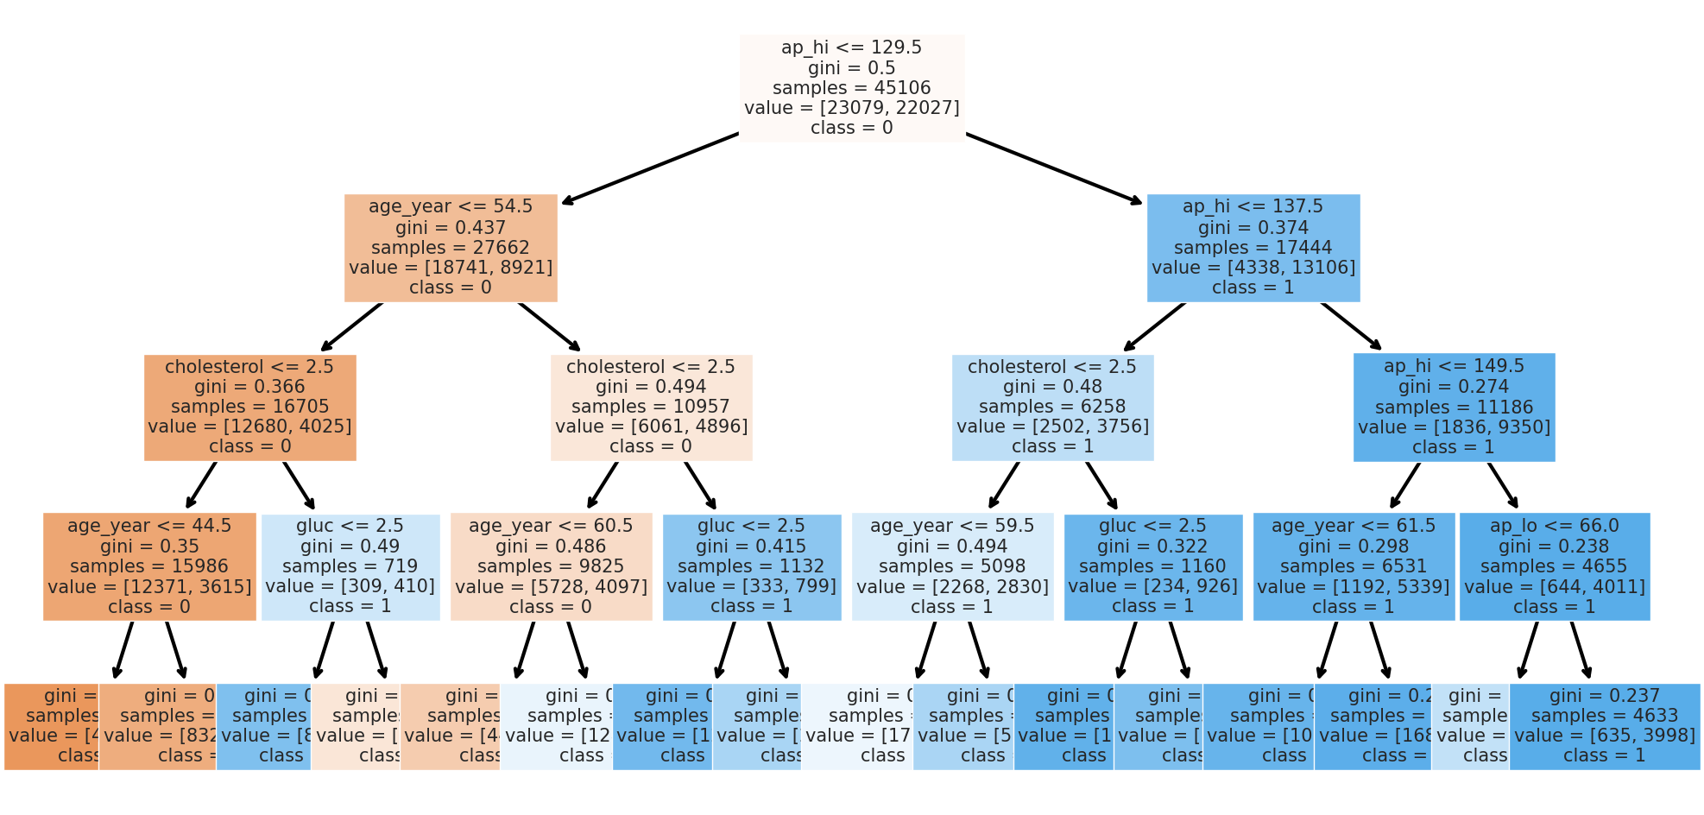
By Ranking of Importance,
ap_hi
age_year
cholesterol
gluc
ap_lo
Decision Tree Model

Slide 19
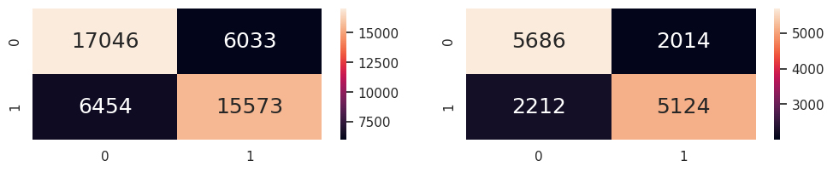
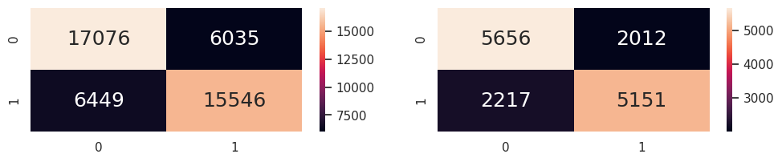
confusion matrix
To find the accuracy of prediction for our Decision Tree Model, we used
Classification Accuracy
Confusion Matrix
Classification Accuracy for Train: 72.3% (0.7231632155367357)
Classification Accuracy for Test: 71.8% (0.7189412077680234)

Slide 20
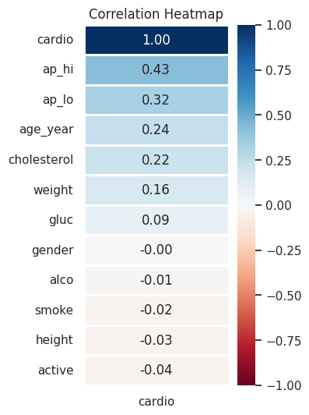
correlation heatmap
In order to find out the correlations between each variables against Cardio specifically, we used Correlation Heatmap.
From this, we found that the 5 variables with the highest correlation to Cardio is:
ap_hi
ap_lo
age_year
cholesterol
weight

Slide 21
Variables Given
In Dataset
Top 5 Variables
Through Correlation
Top 5 Variables
Through Prediction
Age (In Months)
Age_Year
Age_Year
Gender
AP_Hi (Systolic BP)
AP_Hi (Systolic BP)
AP_Hi (Systolic BP)
AP_Lo
(Diastolic BP)
AP_Lo
(Diastolic BP)
AP_Lo
(Diastolic BP)
Cholesterol
Cholesterol
Cholesterol
Gluc
(Glucose)
Gluc
(Glucose)
Alco (Alcohol)
Smoke
Mismatched Variables - Possible Secondary Correlations?
Active
(Exercise)
Height
Weight
Weight

Slide 22
Algorithmic optimisation
Feature Engineering, Gaussian Naive Bayes,
Logistic Regression, Hyperparameter Optimisation

Slide 23
feature engineering

Slide 24
Variables Given
In Dataset
Top 5 Variables
Through Correlation
Top 5 Variables
Through Prediction
Secondary Correlation Variables
Age (In Months)
Age_Year
Age_Year
Age_Year
Gender
Gender
AP_Hi (Systolic BP)
AP_Hi (Systolic BP)
AP_Hi (Systolic BP)
MAP (Mean Arterial Pressure)
AP_Lo
(Diastolic BP)
AP_Lo
(Diastolic BP)
AP_Lo
(Diastolic BP)
Cholesterol
Cholesterol
Cholesterol
Gluc
(Glucose)
Alco (Alcohol)
LSF (Lifestyle Factor)
Active Inverse
(No Exercise)
Smoke
Height
Height
BMI (Body Mass Index)
Weight
Weight
Notes:
Looking at both the Top 5 variable through correlation and prediction, it can be seen that most were similar.
Therefore, we decided to see whether it has any secondary correlation.
Looking at height and weight it could be seen that both can be related to BMI (Body Mass Index)
AP_Hi and AP_Lo could also be calculated using the Mean Arterial Pressure formula.
The remaining few variables, such as Cholesterol, Glucose, Alcohol, Smoke and Active we categorize it together under lifestyle factor.

Slide 25
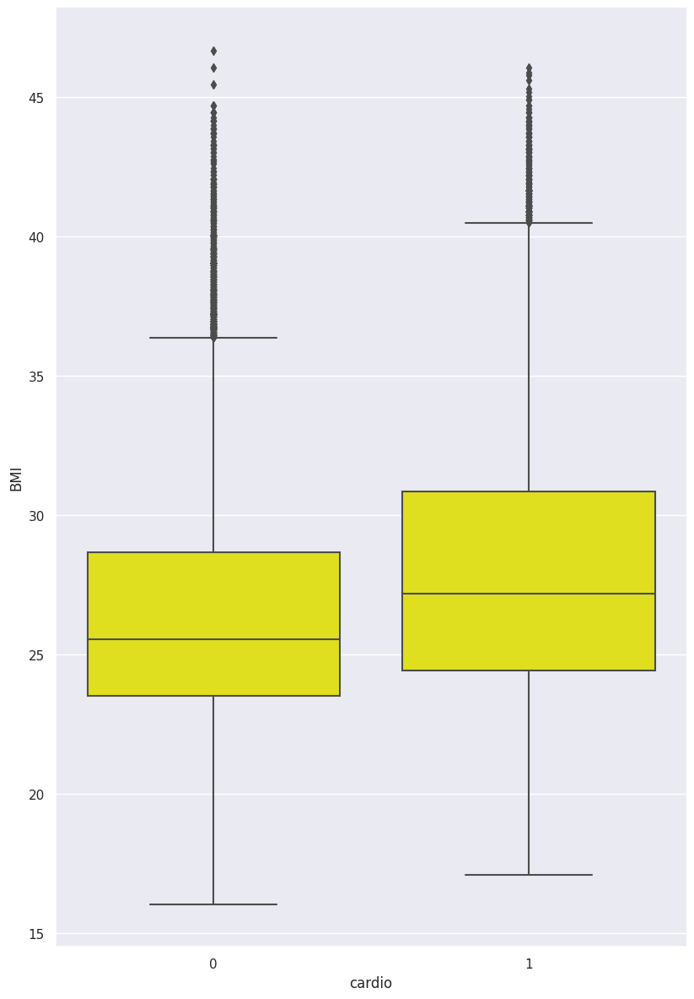
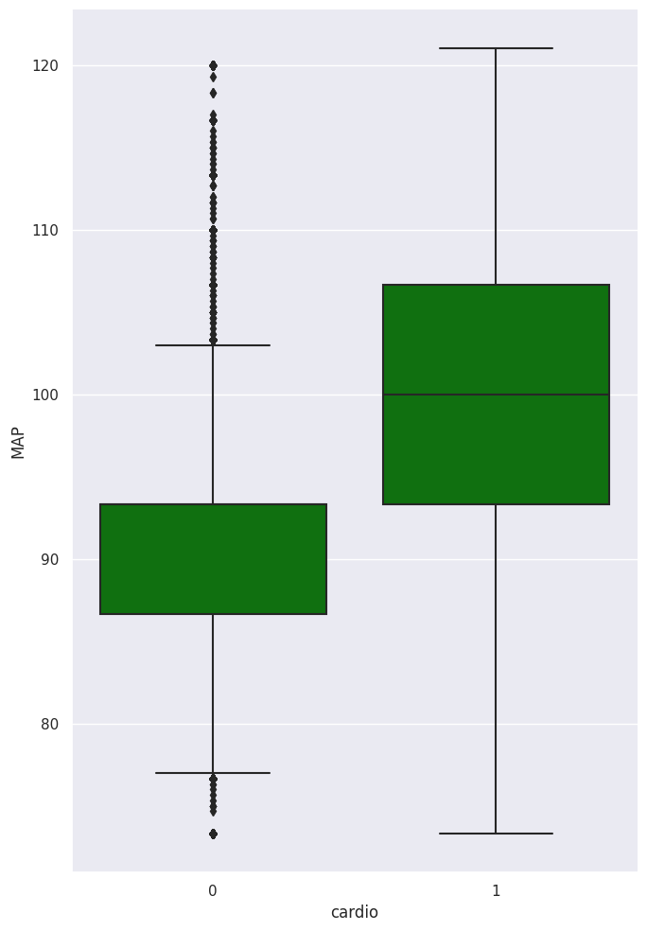
Algorithmic Optimisation
Optimisation through Secondary Correlations
Creation of BMI Variable using Height and Weight
Formula: Weight / Height^2
Creation of MAP [Mean Arterial Pressure]
Typical Formula:
AP_Lo + ⅓ (AP_Hi - AP_Lo)
Simplified Formula: ⅔ AP_Low +⅓ AP_Hi
BMI AGAINST CARDIO
MAP AGAINST CARDIO
Notes:
Using BMI and MAP we plot it against CARDIO.
It can be seen that people who gets Cardiovascular disease generally have higher BMI or Mean Arterial Pressure.

Slide 26
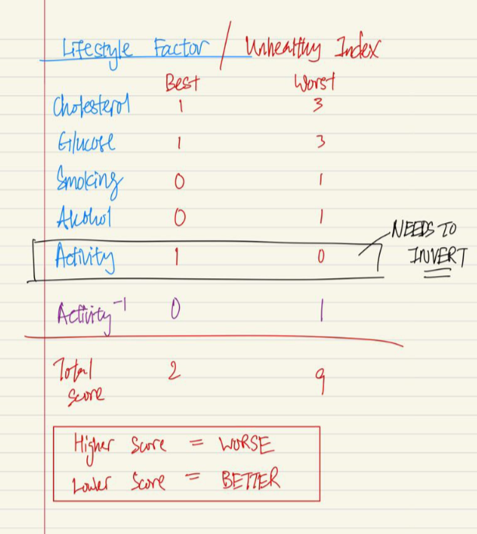
Algorithmic Optimisation
Creation of LSF [Lifestyle Factor]
Lifestyle Factor is a score system that turns each categorical values into a Score, where the higher the score the more unhealthy.
Inverting data of Active to fit the scoring system, creating the new variable of “Non-Active”
Notes:
Creation of Lifestyle Factor, we convert it from categorical to numerical by using a Score system.
Whereby higher score means it is more unhealthy. Cholesterol, glucose, smoking and alcohol gives a +1 meanwhile activity gives a -1 as it is a healthy event.

Slide 27
gaussian
naive
bayers

Slide 28
Gaussian Naive Bayes
Supervised learning algorithms
based on applying Bayes’ theorem with the “naive” assumption of conditional independence between every pair of features given the value of the class variable.
“Naïve” is used because the algorithm incorporates features in its model that are independent of each other.
Modifications in the value of one feature do not directly impact the value of any other feature of the algorithm.
Main advantage of the Naïve Bayes algorithm is that it is a simple yet powerful algorithm.
Notes:
The first algorithm we used was Gaussian Naive Bayes.
Reason for using Gaussian Naive Bayes as it is one of the most simple yet effective and powerful algorithm.
It is fast to build models and to make predictions with this algorithm.

Slide 29
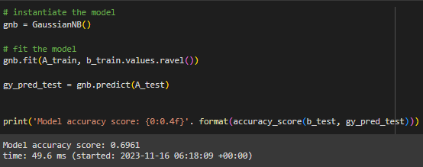
Gaussian Naive Bayes
Notes:
Here, it shows the runtime needed which is 49.6ms to run this algorithm.

Slide 30
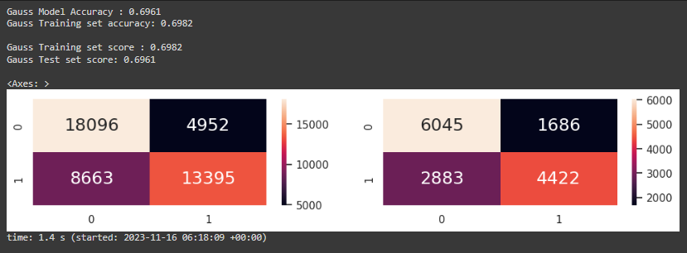
Accuracy
Notes:
The accuracy given for this Gaussian Naive Bayes is around 69-70%

Slide 31
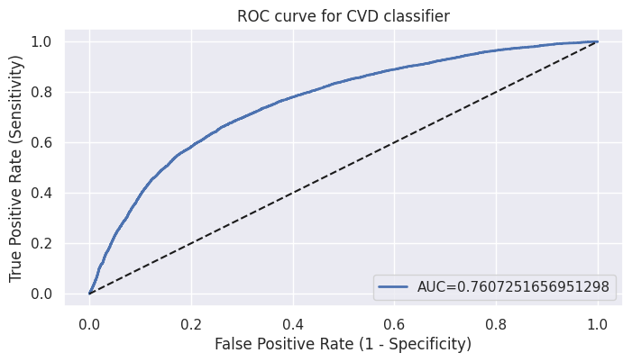
ROC Curve Representation VS Accuracy
Receiver Operator Characteristic (ROC), [(TP) / (TP+FN)] is used to evaluate classifiers predicting rare events like diseases, such as cardiovascular disease.
In contrast, evaluating performance using Accuracy, [(TP + TN) / (TP + TN + FN + FP)] would favor classifiers that always predict a negative outcome for rare events.

Slide 32
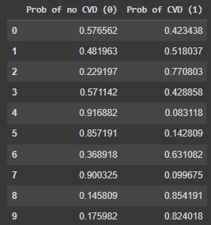
Probability of CVD
Print the first 10 predicted probabilities of two classes - 0 and 1
0 for chances of not getting CVD
1 shows chances of getting CVD
Probability of CVD shown in %
Notes:
Using this algorithm we can predict the probability whether a person will get cardiovascular disease in percentage as shown.
Where 0 is the chances of not getting cardiovascular disease
While 1 is the chance of getting cardiovascular disease
Now, i will pass the time over to Wayne who will speak on other type of algorithm which could be used as well.

Slide 33
logistic
regression

Slide 34
Logistic Regression
Estimates the probability of an event occurring:
- Aims to solve classification problems
- Risk of CVD (Binomial Variable)

Slide 35
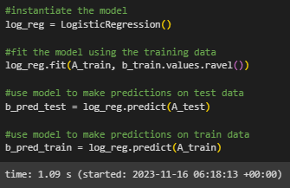
logistic regression

Slide 36
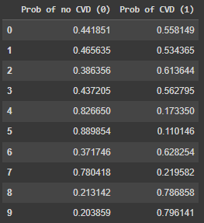
Probability of CVD
Print the first 10 predicted probabilities of two classes - 0 and 1
0 for chances of not getting CVD
1 shows chances of getting CVD
Probability of CVD shown in %

Slide 37
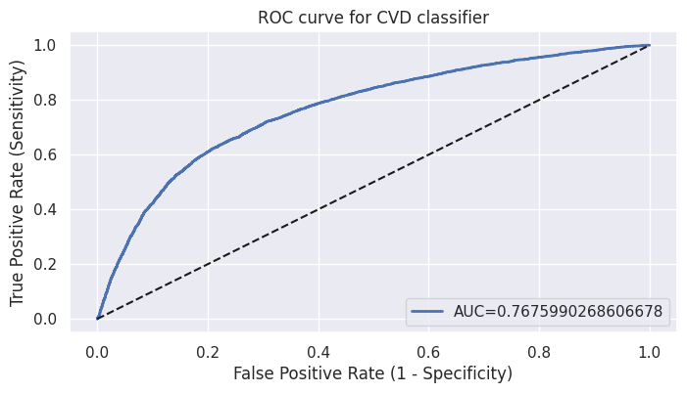
ROC
Notes:
Receiver operating characteristic

Slide 38
hyperparameter
optimisation
(gridsearch)

Slide 39
Improved evaluation
of accuracy

Slide 40
Gridsearch cv
Uses a different combination of all the specified hyperparameters and their values and calculates the performance for each combination and selects the best value for the hyperparameters.
This makes the processing time-consuming and expensive based on the number of hyperparameters involved.

Slide 41

ROC

Slide 42
k-folds cross validation
Cardio_opt dataset is divided into k subsets or folds.
The model is trained and evaluated k times, using a different fold as the validation set each time.
Performance metrics from each fold are averaged to estimate the model's generalization performance.

Slide 43
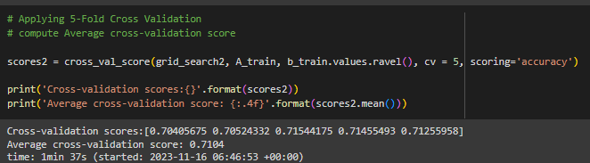
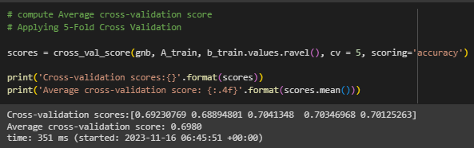
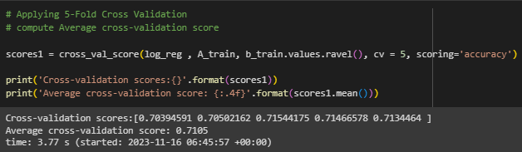
k-folds

Slide 44
Conclusion
Summary

Slide 45
Division of Project
Kern Yang
Introduction
Problem Statement
Problem Objective
Conclusion
Dataset Prep
Initialisation & Acquisition
Dataset Clarity
Shao Chi
Data Preparation
Dataset Clarity
Anomaly and Outlier Removal
Data Analysis and Visualisation
Decision Tree Model
Confusion Matrix
Correlation Heatmap
Nicholas
Feature Engineering
BMI Secondary Relationship
MAP Secondary Relationship
LSF Secondary Relationship
Gaussian Naive-Bayes Model
Wayne
Logistic Regression Model
ROC Curve Plotting
Hyperparameter Optimisation
Grid Search Method
Improved Evaluation of Accuracy
K-Fold Cross Validation

Slide 46
How does our model solve the problem?
Models Used For This Project:
Decision Tree [3.02s]
Accuracy: 0.718
Naive Bayes: Fast and Simple, Low Sensitivity [49.6ms]
Accuracy = 0.696
Sensitivity = 0.7607
Logistic Regression: Longer, Higher Sensitivity [1.08s]
Accuracy [K Fold] = 0.7105
Sensitivity = 0.7675
Grid Search: Optimisation method, takes the longest time, gives highest Sensitivity. [28.1s]
Accuracy [K Fold] = 0.7104
Sensitivity = 0.7676
Through the use of various models, we are able to predict whether a person will get Cardiovascular Disease, with a Sensitivity Rate of 76.8%

Slide 47
Q&A

Slide 48
Thank You
^_^

